Slide 1

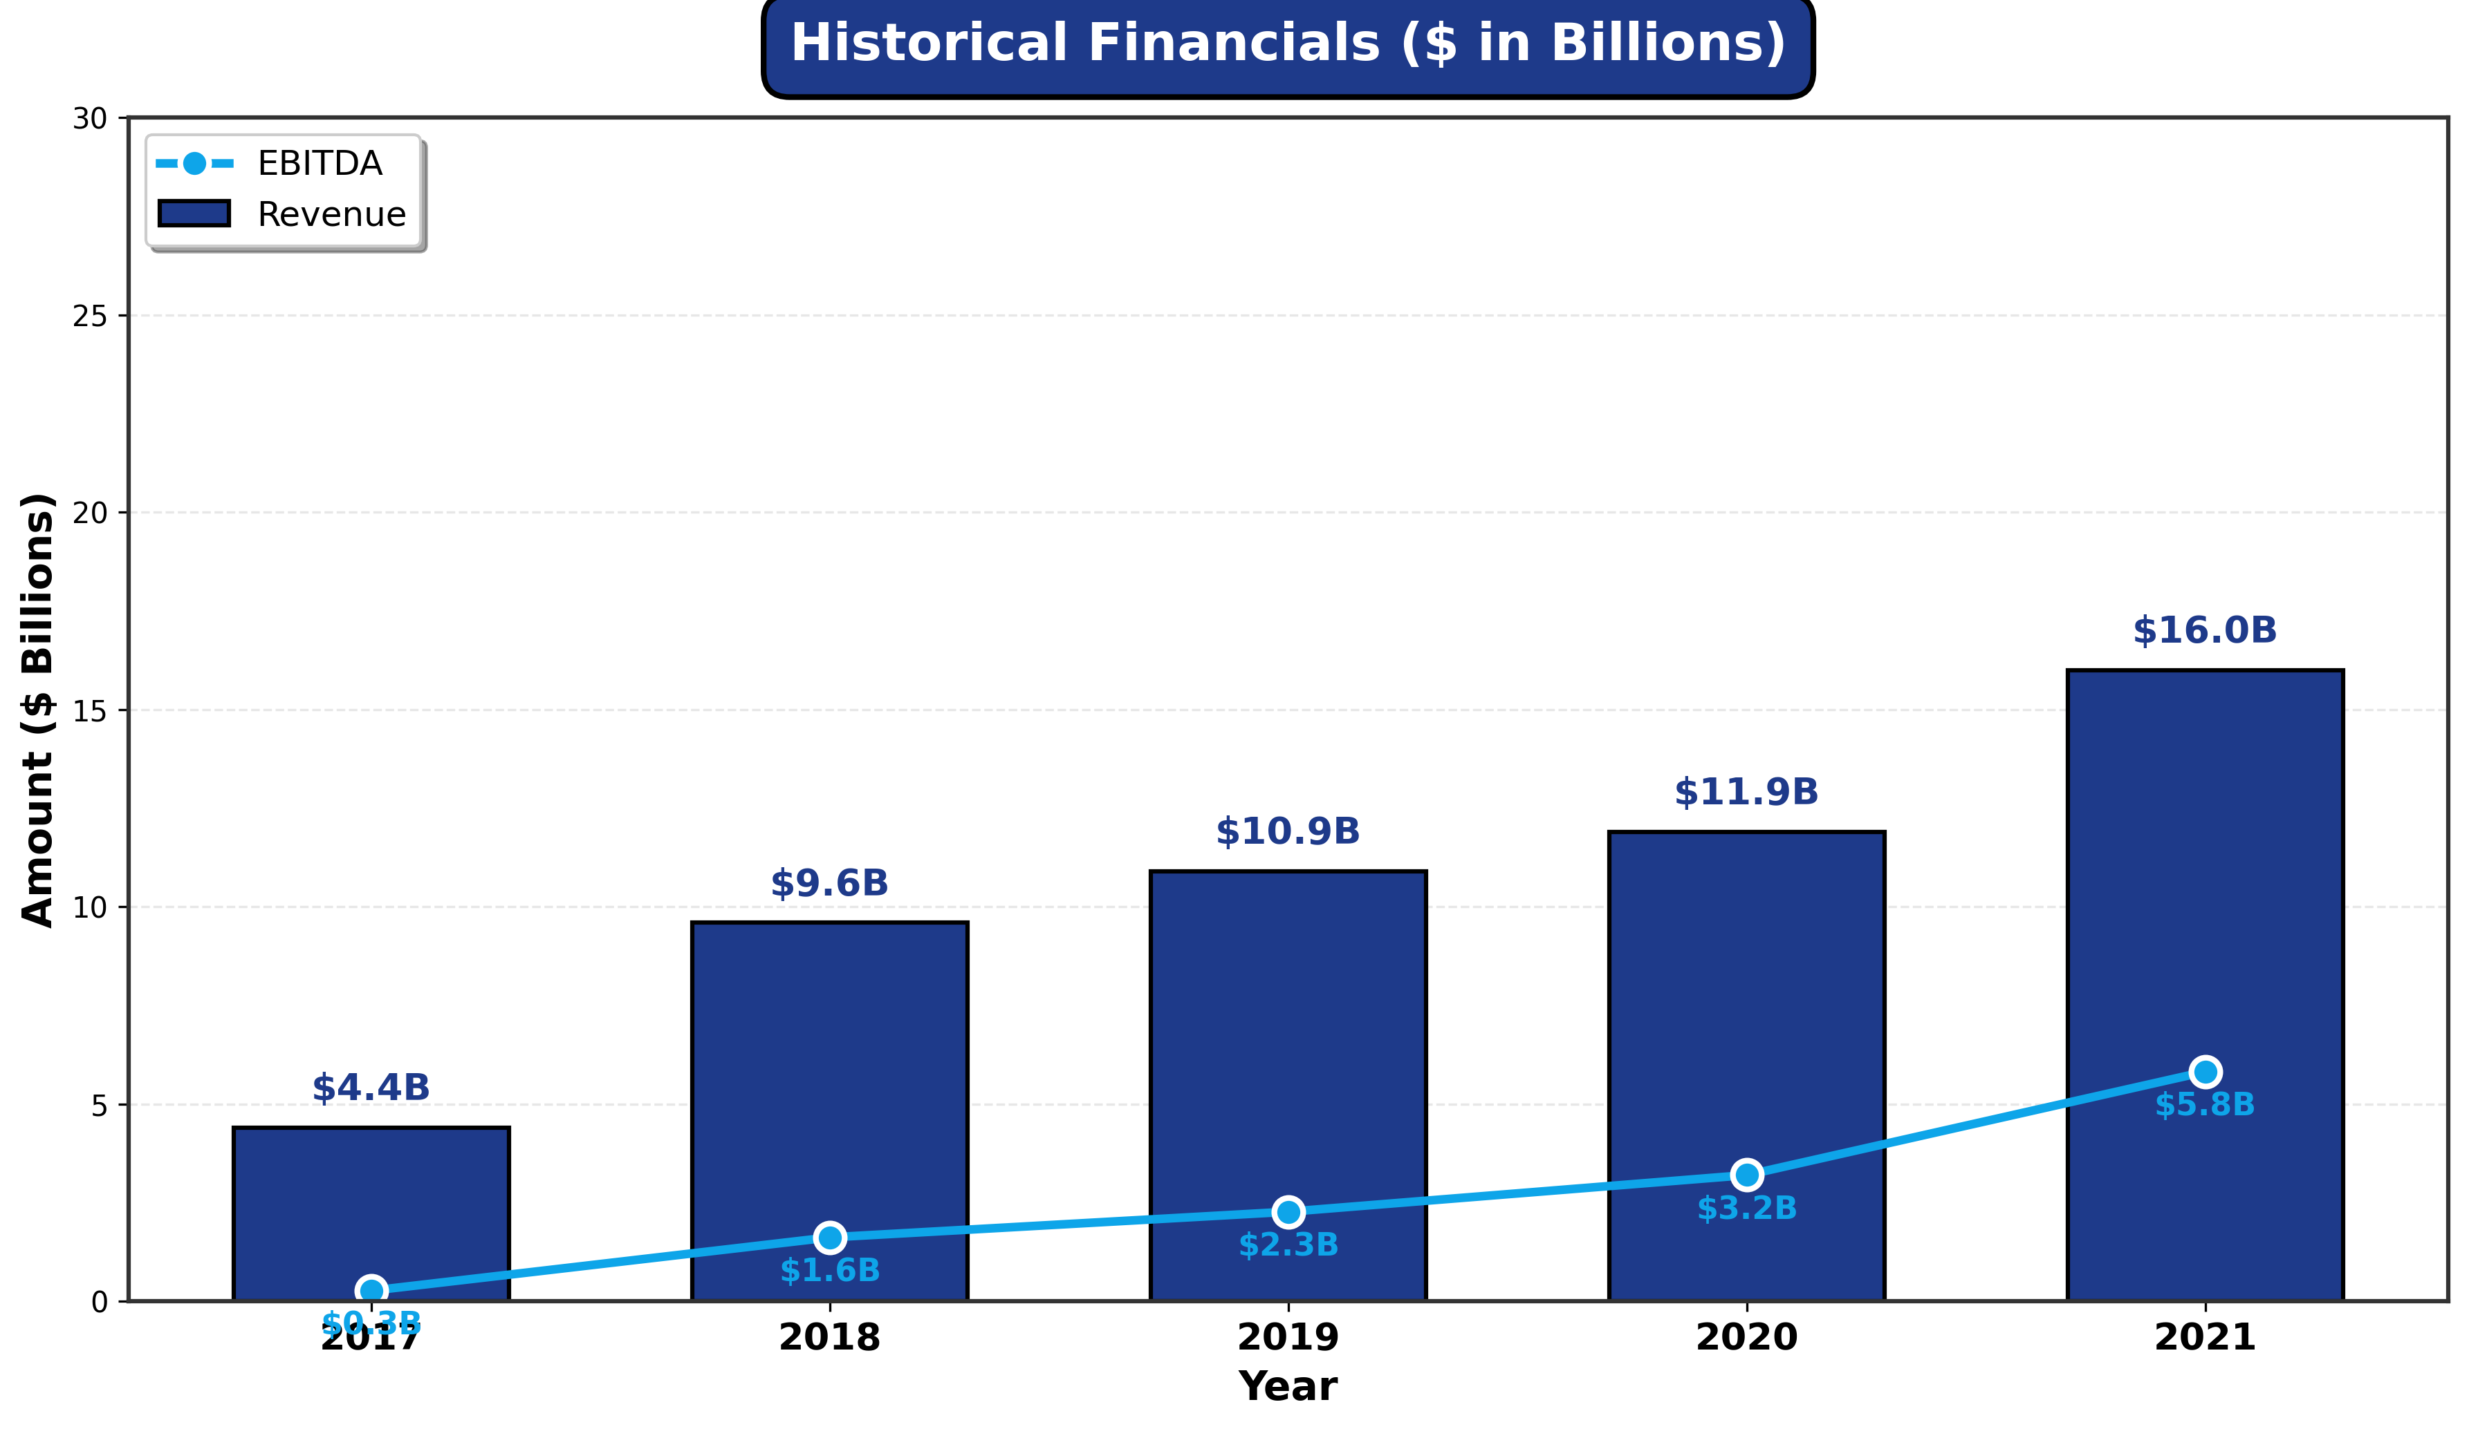
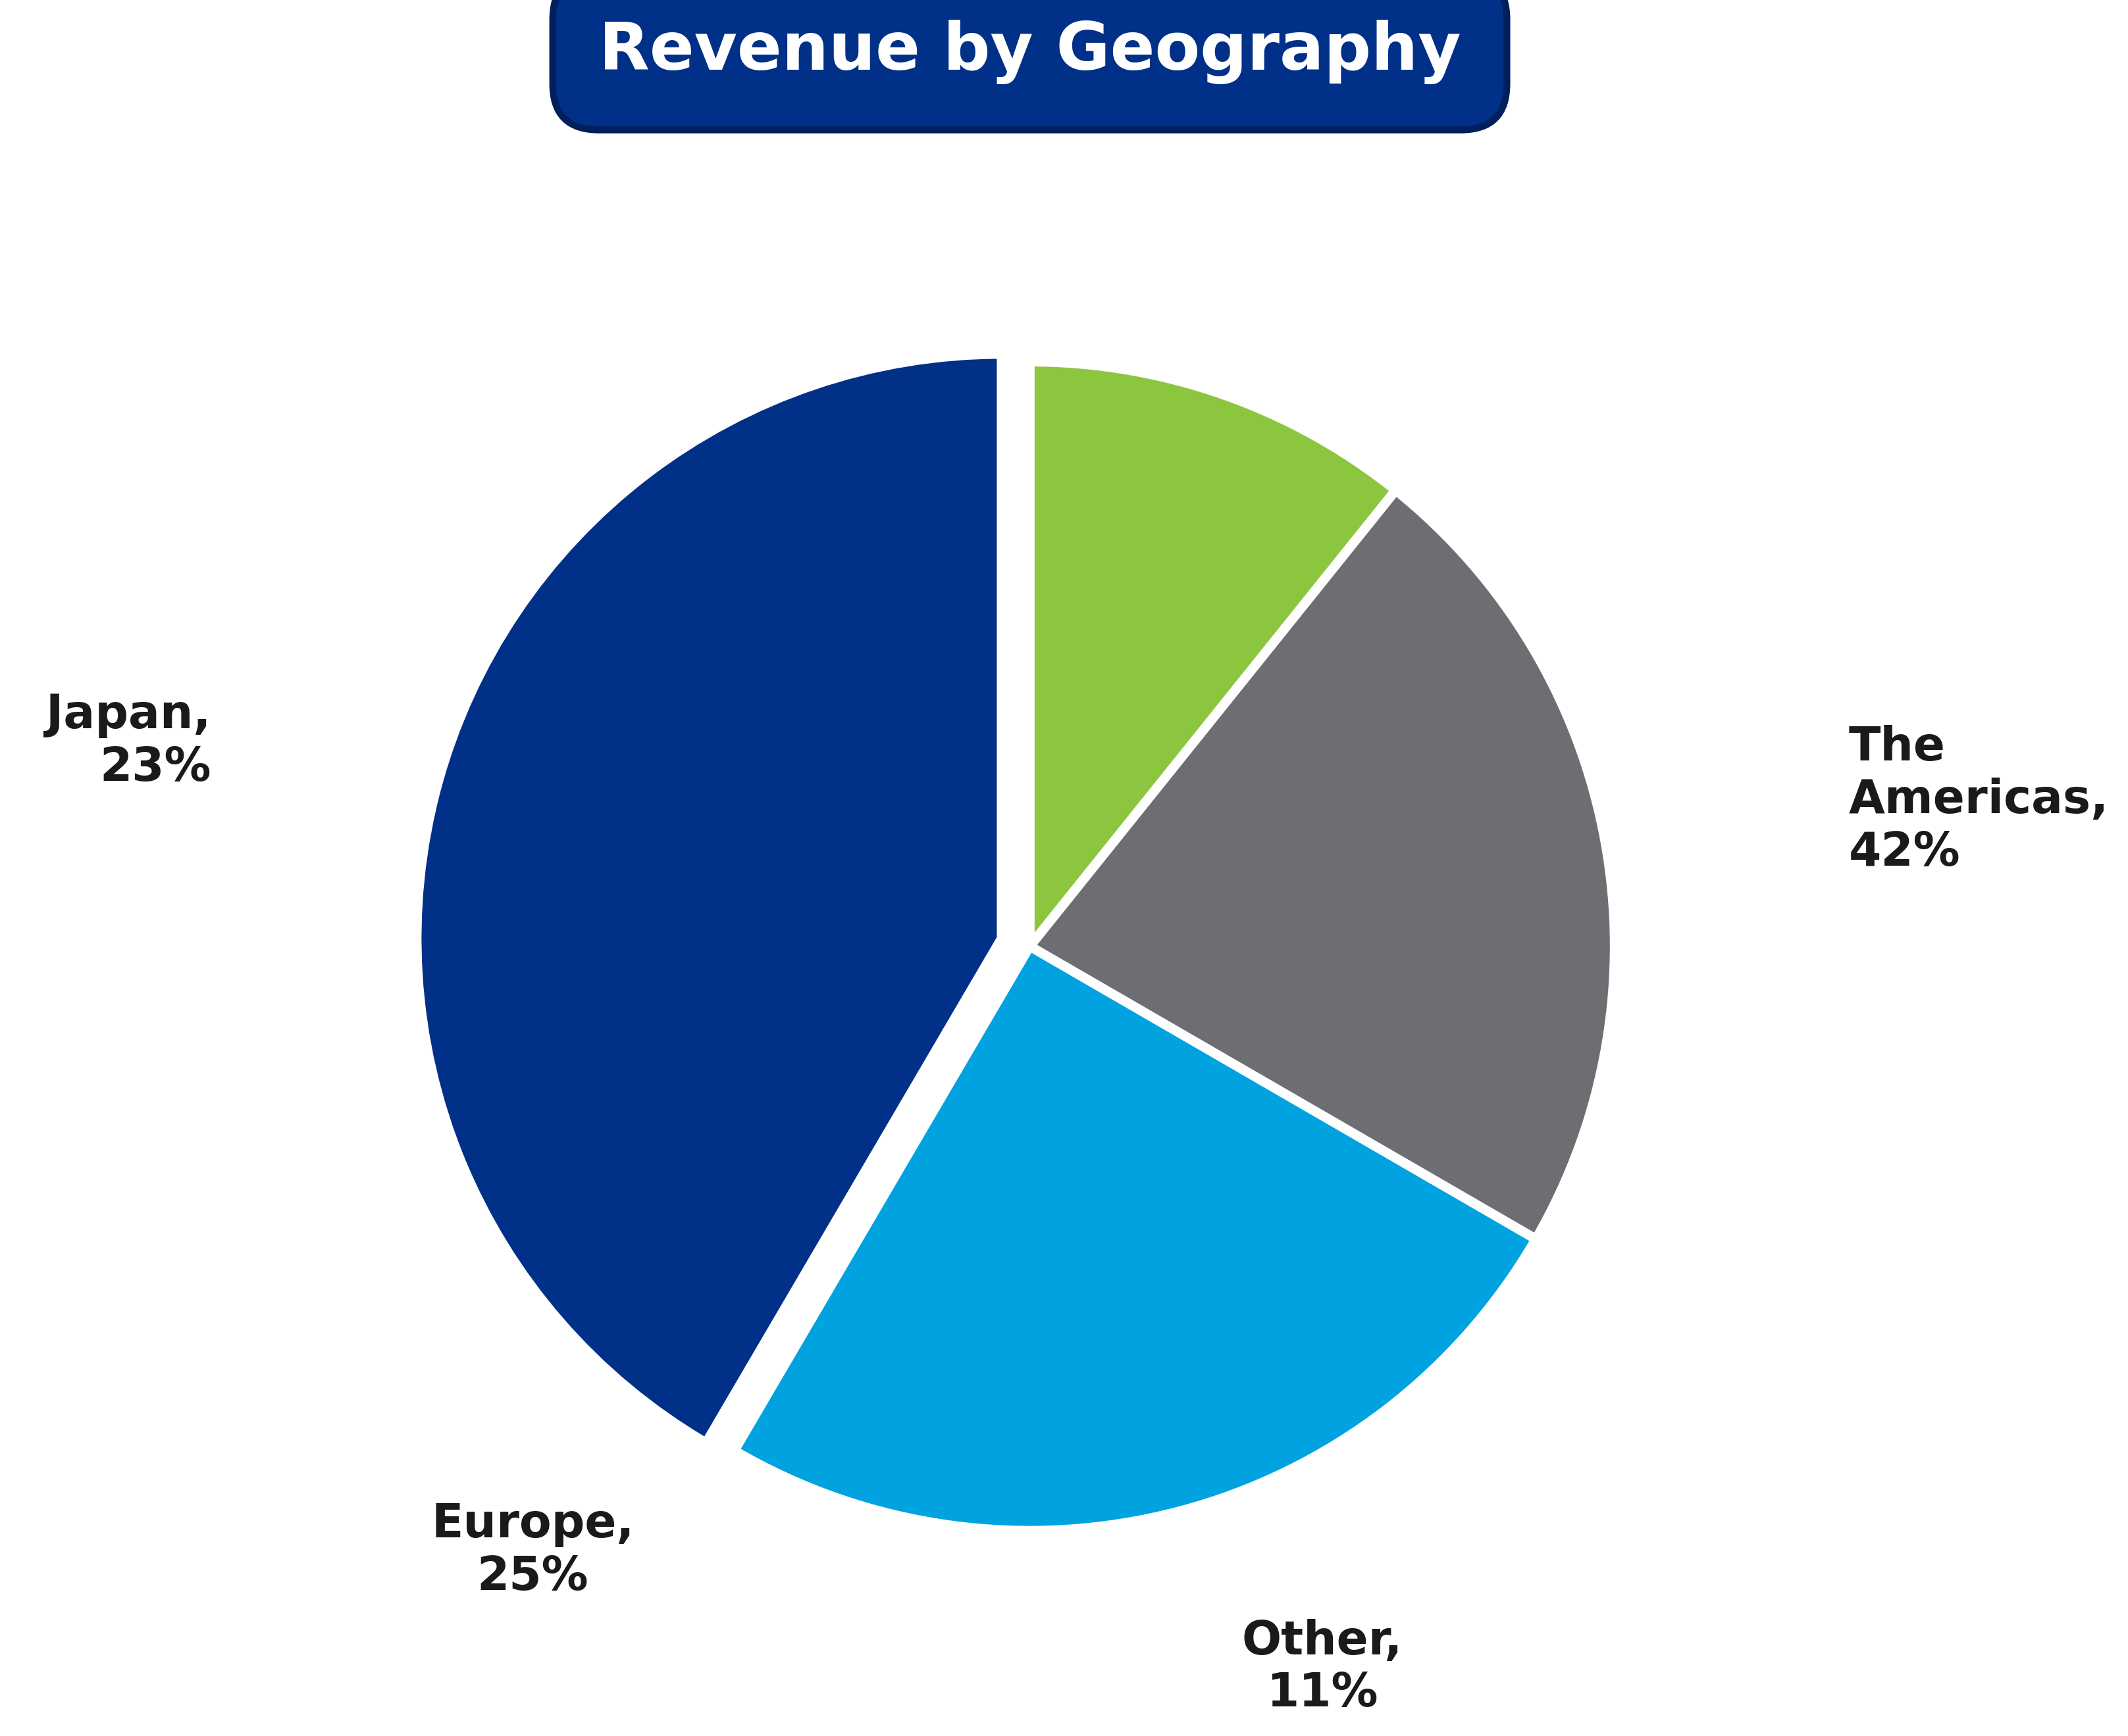

Nintendo | Company profile
Headquarters Kyoto,Japan
Founded- NOV 1947
Employees-6574
President-Shuntaro Furukawa
Overview.
Bussiness-Develops Nintendo switch hardware and software creating family-friendly entertainment experiences for global audiences .
Market Position: Leading video game company with iconic franchises (Mario, Zelda, Pokémon) and unique integrated platform strategy.
Products: Nintendo Switch systems, 230+ million software units sold (FY2021), digital services, mobile apps, and accessories.
Legacy: Founded 1947 in Kyoto; evolved from playing cards to global gaming innovator with 75+ year heritage.
Financials: 36% operating margins, $8.5B cash, minimal debt, expanding IP beyond gaming platforms.
Revenue-$16b
EBITDA $5.8b
Equity- $17b Value
Historical Financials ($ in Billions)
Strategic Rationale
Strengthen Gaming Capabilities – Webflix would be able to immediately accelerate its internal video game content capabilities, allowing it to create stronger, “stickier” relationships with its existing customer base while also serving to expand the size of its total addressable market
Deepen Penetration in APAC Region– By acquiring Nintendo, Webflix would be able to bolster its market penetration in the key Asia-Pacific region, for which it generated
Revenue by Geography
Representative Franchise Assets
Notes:
The strategic acquisition of Octane Fitness, which emphasizes core competencies in specialty retail and international distribution channels, is complementary to Nautilus’ strengths in the direct-to-consumer and mass merchant retail sales, however, an acquisition of Pivotal 5 would further enhance

Slide 2
Nintendo | Discounted Cash Flow Analysis
Implied Enterprise Value & Equity Value from DCF
Forward (2026E) EBITDA |  |  |  |  |  | $6,943.0
Terminal Multiple |  |  |  |  |  | 12.0x
Terminal Value |  |  |  |  |  | $ 83,315.7
Present Value of Terminal Value |  |  |  |  |  | $55,408.7
PV of Unlevered FCF |  |  |  |  |  | $14,150.0
Plus: PV of Terminal Value |  |  |  |  |  | 55,408.7
Implied TEV / Present Value |  |  |  |  |  | $69,558.7
Plus: Cash |  |  |  |  |  | 9,200.0
Less: Debt |  |  |  |  |  | (50.0)
Implied Equity Value |  |  |  |  |  | $78,708.7
Shares Outstanding |  |  |  |  |  | 1,000
Implied Share Price Valuation |  |  |  |  |  | $78.71
Enterprise Value
Implied Share Price
$65,798.3 | $70,523.6 | $75,248.8
$64,611.6 | $69,229.0 | $73,846.4
$63,457.3 | $67,969.8 | $72,482.2
$75.05 | $79.77 | $84.50
$73.86 | $78.48 | $83.10
$72.71 | $77.22 | $81.73
We believe Nintendo should be valued between [$xxB-$xxB], with a midpoint valuation of $xxB

